Slide 1
Overview of Go Programming Language

Slide 2
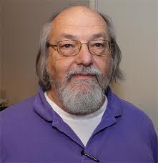

Origin
Developed ~2007 at Google by
Robert Griesemer
Rob Pike
Ken Thompson
Notes:
Ken: worked at Bell Labs for most of his career, Thompson designed and implemented the original Unix operating system (Thompson & Richie). He also invented the B programming language, the direct predecessor to the C programming language, and was one of the creators and early developers of the Plan 9operating systems. Since 2006, Thompson has worked at Google, where he co-invented the Go programming language.
Robert Griesemer is one of the initial designers of the Go programming language. Prior to Go, Robert worked on code generation for Google's V8 JavaScript engine, the design and implementation of the domain-specific language Sawzall, the Java HotSpot virtual machine, and the Strongtalk system. He once wrote a vectorizing compiler for the Cray Y-MP and an interpreter for APL. He is a fan of things that "just work." Robert holds a Ph.D. in computer science from ETH Zurich, Switzerland.
Robert "Rob" C. Pike (born 1956) is a Canadian programmer and author. He is best known for his work on Go (programming language) and at Bell Labs, where he was a member of the Unix team and was involved in the creation of the Plan 9 from Bell Labs and Inferno operating systems, as well as the Limbo programming language.

Slide 3
Outline
Need for a new language
What is new and better in this language
Learning Curve?
Where it is being used and who is using it.
Current state and open source community

Slide 4
Overview
At Google there are many many millions of lines of software on servers mostly in C++ and lots of Java and Python for the other pieces.
All this software runs on zillions of machines, which are treated as a modest number of independent, networked compute clusters.
Thousands of engineers work on the code, at the "head" of a single tree comprising all the software, so from day to day there are significant changes to all levels of the tree.
Notes:
Thousands of engineers work on the code, at the "head" of a single tree comprising all the software, so from day to day there are significant changes to all levels of the tree.
A large custom-designed distributed build system makes development at this scale feasible, but it's still big.

Slide 5
Overview
Development at Google is big, can be slow, and is often clumsy.
The goals of the Go project were to eliminate the slowness and clumsiness of software development at Google, and thereby to make the process more productive and scalable.
The language was designed by and for people who write—and read and debug and maintain—large software systems.

Slide 6
Pain Points
Go does have address the issues that make large-scale software development difficult. These issues include:
slow builds
uncontrolled dependencies
each programmer using a different subset of the language
poor program understanding (code hard to read, poorly documented, and so on)
duplication of effort
cost of updates
version skew
difficulty of writing automatic tools
cross-language builds
A larger view of software engineering is required, and in the design of Go it has been tried to focus on solutions to these problems.
Notes:
Individual features of a language don't address these issues.

Slide 7
Dependencies Management
A file contained about two thousand files that, if simply concatenated together, totaled 4.2 megabytes. By the time the #includes had been expanded, over 8 gigabytes were being delivered to the input of the compiler, a blow-up of 2000 bytes for every C++ source byte.
Java : There are certain tools (JBOSS TattleTale ) can be used to identify unused jars at compile time. Then for each of the jar in that list, one has to search in the project to find if the highest package level of the jar was used anywhere .
Still there are many jars are used to just at compile time.
Notes:
https://stackoverflow.com/questions/19099121/remove-unused-jars-from-project

Slide 8
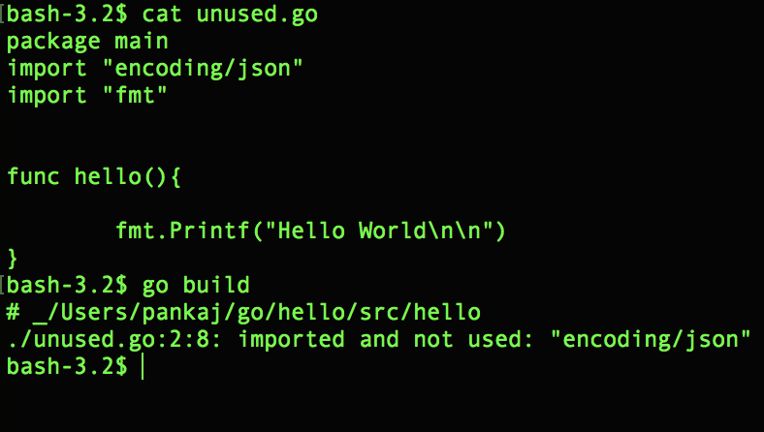
GO way to controlling unused imports
Unused dependencies are a compile-time error (not a warning, an error).

Slide 9
Bigger Changes
There are some much bigger changes too, stepping far from the traditional C, C++, and even Java models. These include linguistic support for:
concurrency
garbage collection
interface types
reflection
type switches

Slide 10
Concurrency
Concurrency is important to the modern computing environment with its multicore machines running web servers with multiple clients, what might be called the typical Google program.
This kind of software is not especially well served by C++ or Java, which lack sufficient concurrency support at the language level.

Slide 11
Concurrency
Go enables simple, safe concurrent programming but does not forbid bad programming.
The motto is, "Don't communicate by sharing memory, share memory by communicating."

Slide 12
Goroutines
A goroutine is a function that is capable of running concurrently with other functions.
package main
import "fmt"
func f(n int) {
for i := 0; i < 10000; i++ {
fmt.Println(n, ":", i)
}
}
func main() {
go f(0)
var input string
fmt.Scanln(&input)
}
go followed by a function invocation

Slide 13
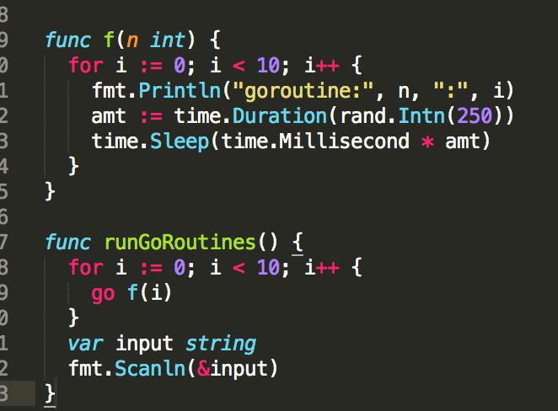
Goroutines
Goroutines are lightweight and we can easily create thousands of them.
go followed by a function invocation

Slide 14
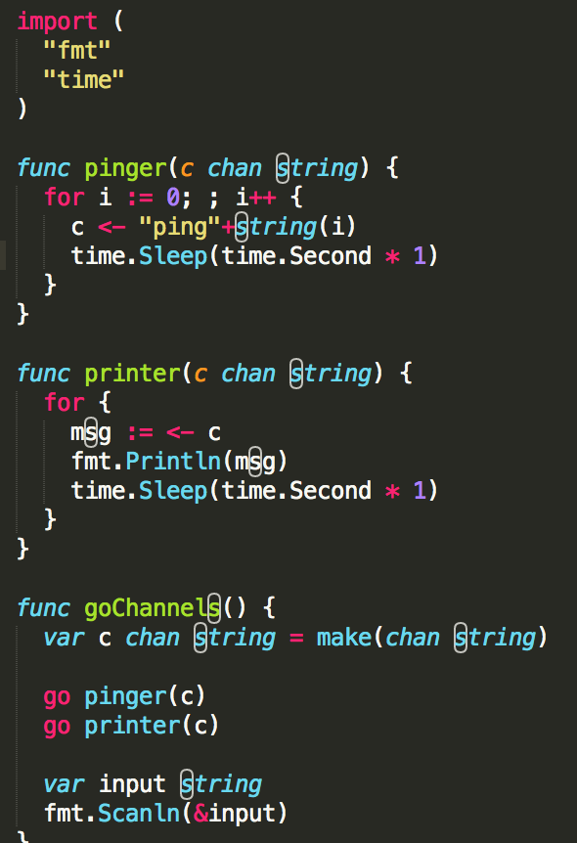
Channels
Channels provide a way for two goroutines to communicate with one another and synchronize their execution.
keyword chan followed by the type of the things that are passed on the channel
Using a channel like this synchronizes the two goroutines. When pinger attempts to send a message on the channel it will wait until printer is ready to receive the message. (this is known as blocking)

Slide 15
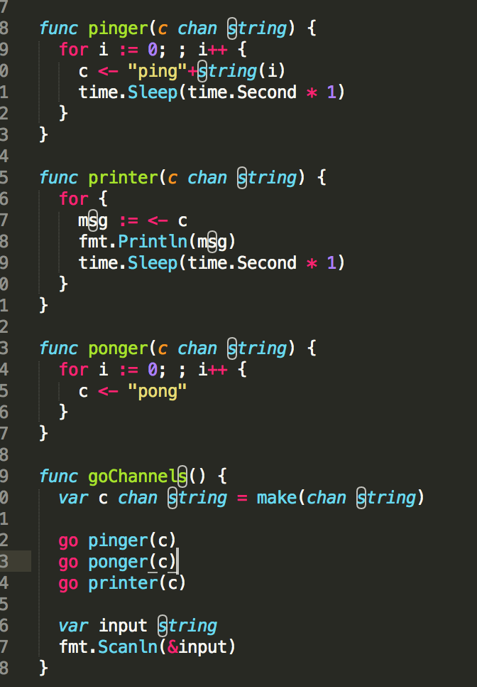
Channels
keyword chan followed by the type of the things that are passed on the channel
Using a channel like this synchronizes the two goroutines. When pinger attempts to send a message on the channel it will wait until printer is ready to receive the message. (this is known as blocking)
By adding ponger…
The program will now take turns printing “ping” and “pong”.

Slide 16
Channel Directions
Channel Direction
We can specify a direction on a channel type thus restricting it to either sending or receiving.
Send-only channels func pinger(c chan<- string).
Attempting to receive from c will result in a compiler error.
Bi-directional func pinger(c chan string).
A channel that doesn't have these restrictions is known as bi-directional.
A bi-directional channel can be passed to a function that takes send-only or receive-only channels, but the reverse is not true.

Slide 17
Garbage collection
Go has no explicit memory-freeing operation: the only way allocated memory returns to the pool is through the garbage collector.
Experience with Java in particular as a server language has made some people nervous about garbage collection in a user-facing system.
The overheads are uncontrollable, latencies can be large, and much parameter tuning is required for good performance.
Go, however, is different. Properties of the language mitigate some of these concerns. Not all of them of course, but some.

Slide 18
Layout of data structures in Go
Consider this simple type definition of a data structure containing a buffer (array) of bytes:
type X struct {
a, b, c int
buf [256]byte
}
In Java, the buf field would require a second allocation and accesses to it a second level of indirection.
In Go, however, the buffer is allocated in a single block of memory along with the containing struct and no indirection is required.
This design can have a better performance as well as reducing the number of items known to the collector. At scale it can make a significant difference.

Slide 19
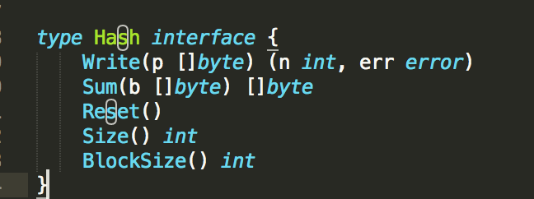
Composition not inheritance
Go takes an unusual approach to object-oriented programming, allowing methods on any type, not just classes, but without any form of type-based inheritance like sub-classing.
Instead, Go has interfaces
A set of methods, no constants
Example:

Slide 20
No Implements Declaration
All data types that implement these methods satisfy this interface implicitly; there is no implements declaration.
Interface satisfaction is statically checked at compile time so despite this decoupling interfaces are type-safe.
All data types that implement all methods satisfy interface implicitly. A datatype can satisfy more than one interface.

Slide 21
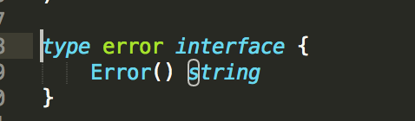
Errors
Go does not have an exception facility in the conventional sense, that is, there is no control structure associated with error handling.
A pair of built-in functions called panic and recover allow the programmer to protect against such things. (rarely used, and not integrated into the library)
For error handling is a pre-defined interface
Notes:
Go does provide mechanisms for handling exceptional situations such as division by zero. A pair of built-in functions called panic and recover allow the programmer to protect against such things.
However, these functions are intentionally clumsy, rarely used, and not integrated into the library the way, say, Java libraries use exceptions.)
First, there is nothing truly exceptional about errors in computer programs. For instance, the inability to open a file is a common issue that does not deserve special linguistic constructs; if and return are fine.
f, err := os.Open(fileName) if err != nil { return err }

Slide 22
open source
compiled, statically typed
very fast compilation
C-like syntax
garbage collection
built-in concurrency
no classes or type inheritance or overloading or generics
unusual interface mechanism instead of inheritance

Slide 23
Where it is today?
On September 25, 2007, Discussion to create a new programming language.
November 10, 2009 Twi compilers created leading to the creation of an open-source release.
March 28, 2012 release of GO 1.
Notes:
A programing language is described by a combination of semantics and syntax.
The semantics gives meaning of every construct that is possible in that programming language and syntax give us its structure.
A programming language has a Grammar
CFG: Context Free Grammar: is a certain type of formal grammar.
A context-free grammar G is defined by the 4-tuple:^{[5]}
{ G=(V, E(sigma) ,R,S)} where
V is a finite set; each element {\displaystyle v\in V} is called a nonterminal character or a variable. Each variable represents a different type of phrase or clause in the sentence. Variables are also sometimes called syntactic categories. Each variable defines a sub-language of the language defined by G.
Σ is a finite set of terminals, disjoint from V, which make up the actual content of the sentence. The set of terminals is the alphabet of the language defined by the grammar G.
R is a finite relation from V to {\displaystyle (V\cup \Sigma )^{*}}, where the asterisk represents the Kleene star operation. The members of R are called the (rewrite) rules or productions of the grammar. (also commonly symbolized by a P)
S is the start variable (or start symbol), used to represent the whole sentence (or program). It must be an element of V.

Slide 24
Releases
go1 (released 2012/03/28)
go1.1 (released 2013/05/13)
go1.2 (released 2013/12/01)
go1.3 (released 2014/06/18)
go1.4 (released 2014/12/10)
go1.5 (released 2015/08/19) ( Compiler translated from C to GO)
go1.6 (released 2016/02/17)
go1.7 (released 2016/08/15)
go1.8 (released 2017/02/16)
go1.9 (released 2017/08/24)
go1.10 (released 2018/02/16)
go1.11 (released 2018/08/24)

Slide 25
Question?
In which language Java language is written?
Notes:
The Sun/Oracle VM is written in C++. The BEA/Weblogic/Oracle VM is written in C. IBM's J9 is (I believe) written in C++. There are a couple of VMs actually written in Java, and one even written in Lisp. The vast majority of JVMs also include assembler code to speed certain "hot" areas.
A AL

Slide 26
Code Base
Standard Libraries
147 packages
Examples:
math, syslog, io, Plugins, tars, zip, drivers, sql, csv, json, xml, errors etc etc
Sub-repositories
These packages are part of the Go Project but outside the main Go tree
17 Packages
Example:
image, text, time, tools
Notes:
Define core language with basic alphabets and goals/rules/ constraints.
Standard Libraries….define interfaces in these standard libraries.
With so much work already done..most of the core things are in C applications are in C++ (things I can say
If you want to participate…
There are lots of things to do.
Convert C libraries, tools, programns.
C is very close to hardware… you have to understand benefits of converting from C to GO
The Sun/Oracle VM is written in C++. The BEA/Weblogic/Oracle VM is written in C. IBM's J9 is (I believe) written in C++. There are a couple of VMs actually written in Java, and one even written in Lisp. The vast majority of JVMs also include assembler code to speed certain "hot" areas.

Slide 28
What is it?
Nothing new?
Difficult to write code
Only one way to write code
On For statement ( No While/Until)

Slide 29
New Language
Whenever a new language or new version of a new language is release, we see:?
As
Asa
Asa
Sas
Sas

Slide 30
No Generics
No Classes
No Inheritence
No constructors.
No annotations.
No generics.
No exceptions.

Slide 31
Need?
Simplicity
Safety
Readability
Efficient/Speed
Notes:
No easy to write.
Minimal: Only one way to do a thing. ( only for 4 loop ,no repeat/until)
Able to call method,any instance of any type
Methods of instance of any class

Slide 32
Nothing New
Notes:
Every time a new version of a language comes. There are more features, more libraries etc

Slide 33
Where is Go language is being used?
Go runs directly on underlying hardware. One most considerable benefit of using C, C++ over other modern higher level languages like Java/Python is their performance. Because C/C++ are compiled and not interpreted. Processors understand binaries.
Notes:
https://medium.com/exploring-code/why-should-you-learn-go-f607681fad65

Slide 34
Top 5 editors
LiteIDE
Visual Studio Code
Eclipse with GoClipse
Atom IDE
Vim
https://github.com/golang/go/wiki/IDEsAndTextEditorPlugins

Slide 35
C++ vs Go
Simplicity
C++ | GO
Semi colon at the end of line
a = b; | No Semicolon a = b
No () parentheses with if and for
If (a >2){ …} for (i := 0; i < 100; i++){ … } | If a > 2 … for i := 0; i < 100; i++ { … }
Types after names
Foo foo = 2; | var foo Foo = 2

Slide 36
C++ vs Go
Simplicity
C++ | GO
No Implicit Conversion (also applies to comparison via == and !=)
int a = -2; uint c = a; float64 d = 1.345; int e = ‘c’; | Compiler error var a int = -2 var b uint = a var d float64 = 1.345 var e int = `c`
No Enums
Only for loops
for i := 0; i < 100; i++ {…. } ... for keepGoing {….} ... for i, c := range things {…}

Slide 37
C++ vs Goc
Simplicity
C++ | GO
Arrays - Slices
int a = -2; uint c = a; float64 d = 1.345; int e = ‘c’; | Compiler error var a int = -2 var b uint = a var d float64 = 1.345 var e int = `c`
No Enums
Only for loops
for i := 0; i < 100; i++ {…. } ... for keepGoing {….} ... for i, c := range things {…}

Slide 38
New in Go Language
A function can return a reference to a local variable (declared in a method).
package main
import "fmt"
type Record struct {
i int
}
func returnLocalVariableAddress() *Record {
return &Record{1} // a new record is allocated on the stack
}
func main() {
r := returnLocalVariableAddress()
fmt.Printf("%d", r.i)
}
Go performs pointer escape analysis. If the pointer escapes the local stack, which it does in this case, the object is allocated on the heap. If it doesn't escape the local function, the compiler is free to allocate it on the stack
Notes:
The issue here is that when you create the local variable it is allocated on the stack and is therefore unavailable once the function finishes execution.
Go performs pointer escape analysis. If the pointer escapes the local stack, which it does in this case, the object is allocated on the heap. If it doesn't escape the local function, the compiler is free to allocate it on the stack (although it makes no guarantees; it depends on whether the pointer escape analysis can prove that the pointer stays local to this function).

Slide 39
New in Go Language
Closures: You can write functions inside functions and you can return functions just like in a functional language.
package main
import "fmt"
func CounterFactory(j int) func() int {
i := j
return func() int {
i++
return i
}
}
func main() {
r := CounterFactory(13)
fmt.Printf("%d\n", r())
fmt.Printf("%d\n", r())
fmt.Printf("%d\n", r())
}
Notes:
The issue here is that when you create the local variable it is allocated on the stack and is therefore unavailable once the function finishes execution.
Go performs pointer escape analysis. If the pointer escapes the local stack, which it does in this case, the object is allocated on the heap. If it doesn't escape the local function, the compiler is free to allocate it on the stack (although it makes no guarantees; it depends on whether the pointer escape analysis can prove that the pointer stays local to this function).

Slide 40
New in Go Language
Function can have multiple return types
For instance:
func getThings() (int, Foo) {
return 2, getFoo()
}
a, b := getThings()
Notes:
The issue here is that when you create the local variable it is allocated on the stack and is therefore unavailable once the function finishes execution.
Go performs pointer escape analysis. If the pointer escapes the local stack, which it does in this case, the object is allocated on the heap. If it doesn't escape the local function, the compiler is free to allocate it on the stack (although it makes no guarantees; it depends on whether the pointer escape analysis can prove that the pointer stays local to this function).

Slide 41

New in Go Language
Arrays, Slices and Map
Array is a fixed length array. var x [5]int
A slice is a segment of an array. Like arrays slices are indexable and have a length. Unlike arrays this length is allowed to change.
var x []float64
or
x := make([]float64, 5, 10)
10 represents the capacity of the underlying array which the slice points to:
or
arr := [5]float64{1,2,3,4,5}
x := arr[3:5]
Notes:
The issue here is that when you create the local variable it is allocated on the stack and is therefore unavailable once the function finishes execution.
Go performs pointer escape analysis. If the pointer escapes the local stack, which it does in this case, the object is allocated on the heap. If it doesn't escape the local function, the compiler is free to allocate it on the stack (although it makes no guarantees; it depends on whether the pointer escape analysis can prove that the pointer stays local to this function).

Slide 42
New in Go Language
Map
A map is an unordered collection of key-value pairs.
var x map[string]int
x := make(map[string]int). ////Length is 0
x["key"] = 10 // length is 1
x["key"] = 10 // length is 2
fmt.Println(x)
delete(x, 1)
Notes:
The issue here is that when you create the local variable it is allocated on the stack and is therefore unavailable once the function finishes execution.
Go performs pointer escape analysis. If the pointer escapes the local stack, which it does in this case, the object is allocated on the heap. If it doesn't escape the local function, the compiler is free to allocate it on the stack (although it makes no guarantees; it depends on whether the pointer escape analysis can prove that the pointer stays local to this function).

Slide 43
GO is not a replacement for Java/C/(C++?) even on a language level.
Java and Go are not supposed to serve the same type of tasks –
Java is enterprise development language,
Go is a system programming language.

Slide 44
Future
The new darwin/arm64 port and external linking features fuel the
Go mobile project, an experiment to see how Go might be used for building apps on Android and iOS devices. (The Go mobile work itself is not part of this release.)

Slide 45
Companies using Go
Many other companies use Go as well; the list is very long, but a few of the better known are:
Uber
Novartis
Basecamp
BBC Worldwide
Canonical
Heroku
Nokia
SoundCloud

